Slide 1

Olist Store
Data Analysis Project

Slide 2
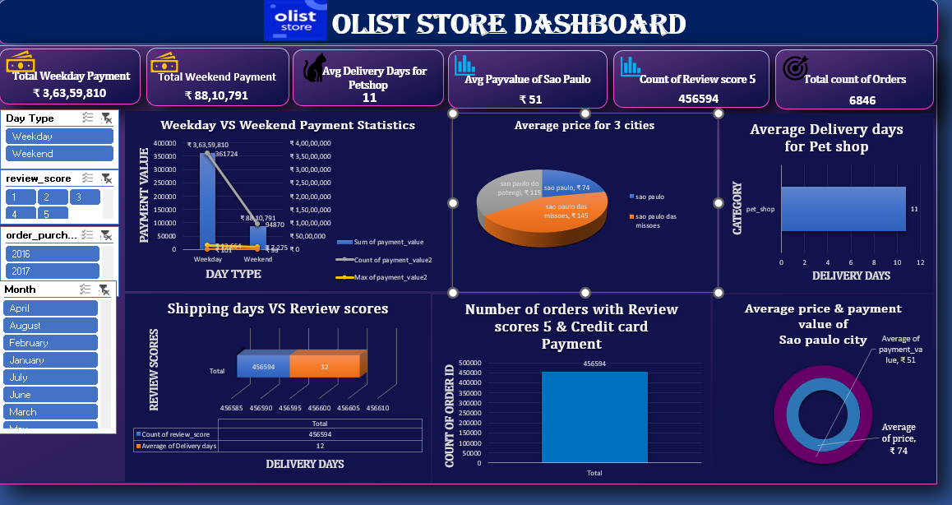
Excel Dashboard

Slide 3
Key Insights
• Faster deliveries = Better reviews (clear positive correlation).
• Pet Shop has longer delivery days, indicating a issue.
• Credit card payments mostly linked to Review Score 5 customers.

Slide 4
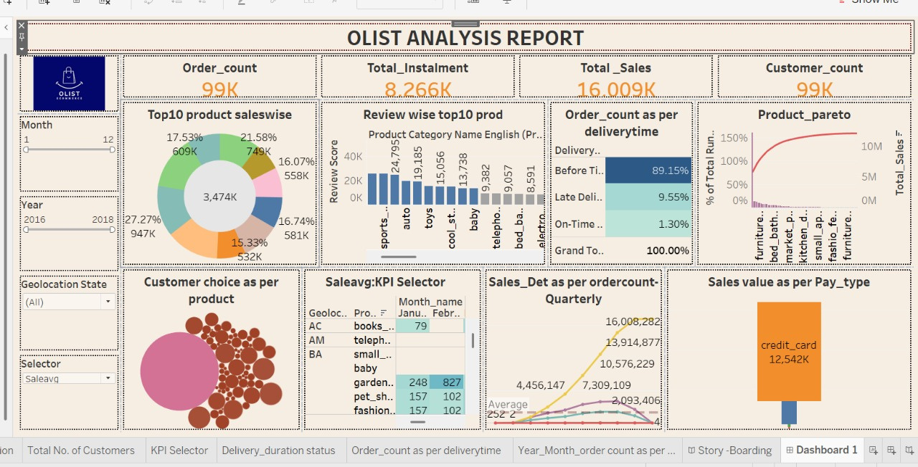
Tableau Dashboard

Slide 5

Top 3 Key Insights
High sales: 99K orders and strong total revenue.
Top products dominate: A few categories generate most sales.
Delivery performance strong: 89% orders delivered before time.

Slide 6
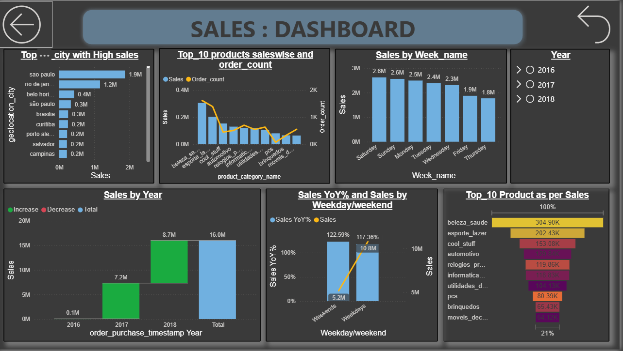
Power BI Sales Dashboard

Slide 7
Top 3 Key Insights
Weekdays generate higher sales than weekends.
Top products (beleza_saude, esporte_lazer) contribute most of the revenue.
São Paulo is the highest-sales city among all regions.

Slide 8
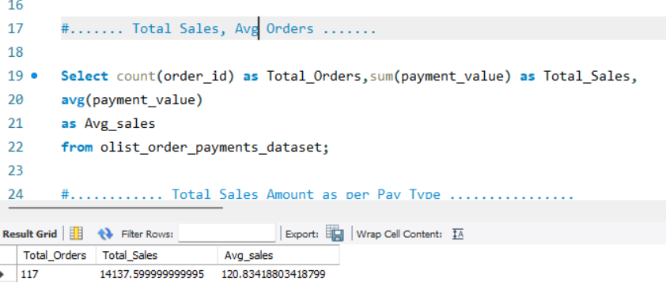
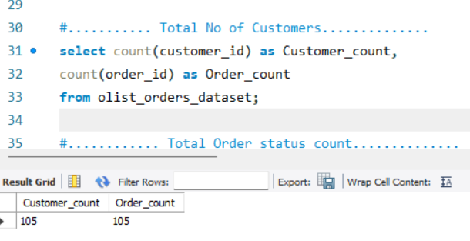
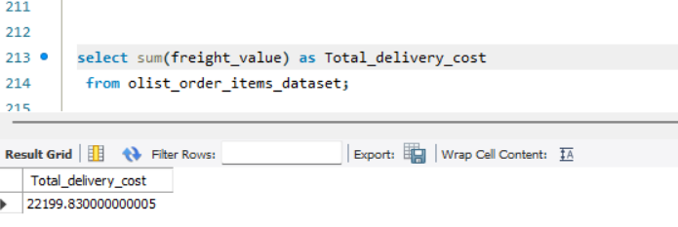
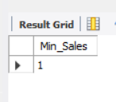
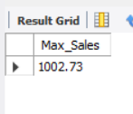
SQL

Slide 9
Key Insights
Temporal Trends: Segment sales by Month, Year, and Weekday/Weekend to find peak selling seasons.
Performance Ranking: Identify Top/Bottom 10 Products and Cities by sales for inventory and marketing strategy.
Customer Value (CLV): Identify the highest-revenue customers to assess lifetime value.

Slide 10
Recommendations
Try to reduce late deliveries to improve customer satisfaction.
Promote top-selling products like Sports, Auto, and Toys.
Give more attention to top cities like São Paulo and Rio to increase sales.
Encourage credit card payments, since they bring the highest revenue.
Monitor sales regularly (monthly & quarterly) to plan better.

Slide 11
THANK YOU
for watching this presentation

